Slide 1





DEVELOPMENT OF A PREDICTIVE IOT-BASED SYSTEM FOR REAL-TIME AIR QUALITY MONITORING AND ROUTE OPTIMIZATION
Progress Presentation-II (90% Completion)
2024 - 078
10/09/2024

Slide 2




Meet Our Team !
Supervisor : Ms. Chathurangika Kahandawarachi
Co-supervisor : Ms. Pipuni Wijeseri
Inthikhaff M. I. M IT21058028
Rimas M. J. M
IT21003714
KUMARI J.M.D
IT21152832
Pasan M.G.R IT21057588
2
10/09/2024

Slide 3
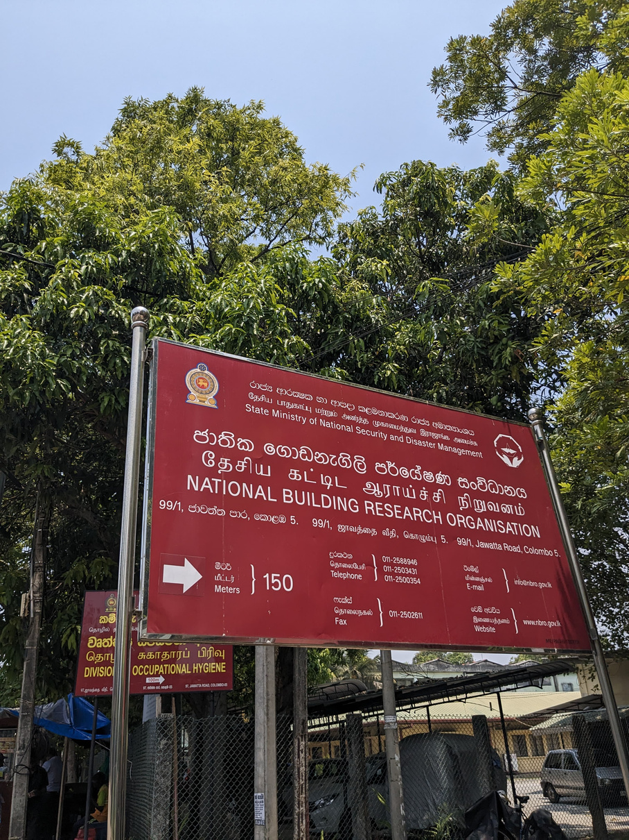

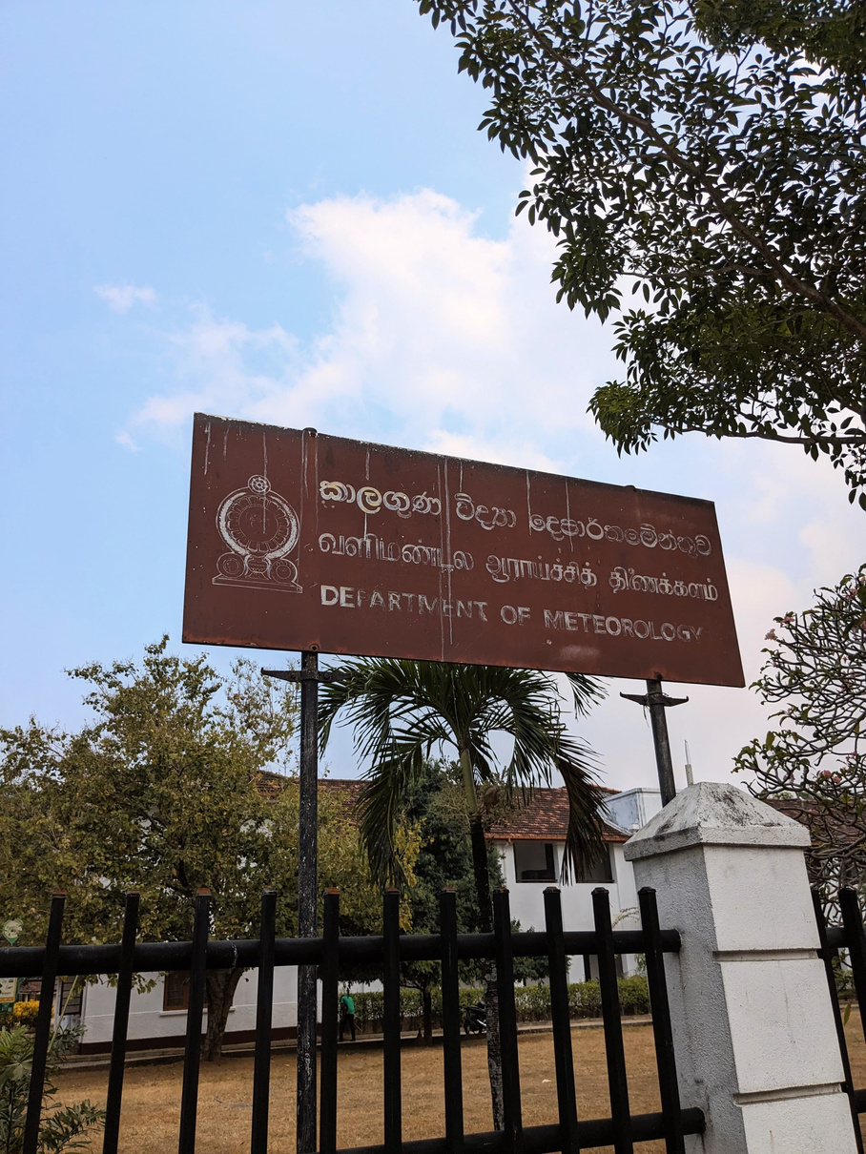
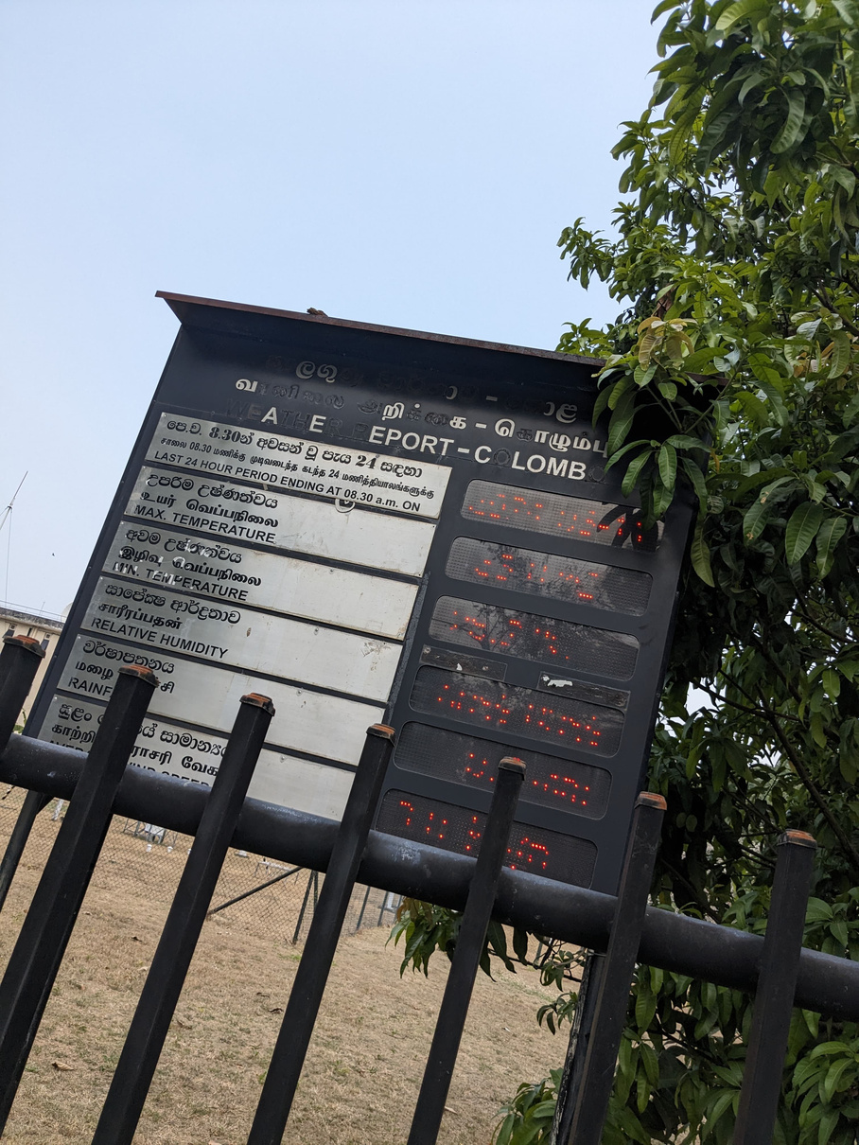
SNAPS FROM THE FIELD VISITS
3
0/09/2024

Slide 4


RESEARCH PROBLEM
How can air quality monitoring and analysis be integrated into a predictive system to forecast and mitigate environmental risks?
How we define Air pollution with the creation of IoT device.
How we can develop user-friendly and easily understandable Pollution map?
How can we encourage people to travel with minimal levels of pollution ?
How can we enhance transparency and raise awareness among the public regarding air pollution and pollution levels?
How can we find a solution for school students who are being affected by air pollution?
5
06/05/2024

Slide 5




RESEARCH OBJECTIVES
Sub Objectives
Main Objective
Develop sensor-based devices with a focus on accuracy and value creation on Air pollution.
Minimize the adverse effects of air pollution for the general public population while travelling.
Implement future pollution level prediction and forecasting mechanisms
Create a user-friendly real-time pollution heatmap accessible to all.
Develop real-time route generation based on pollution levels.
5
06/05/2024

Slide 6
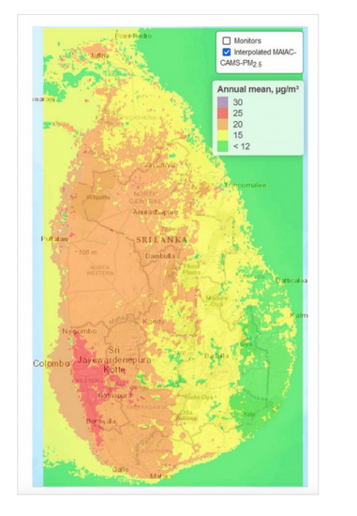
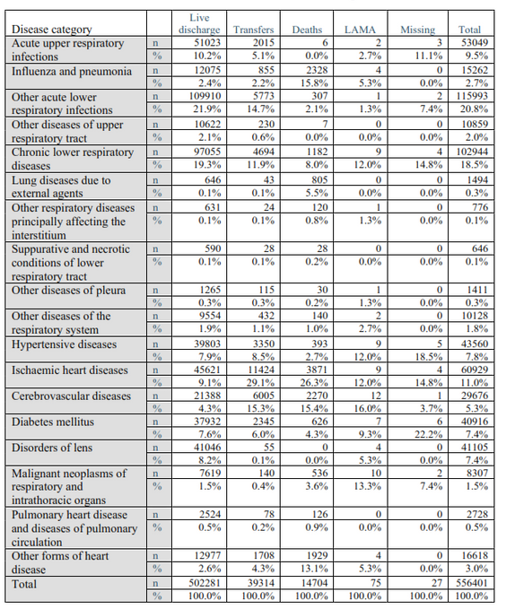
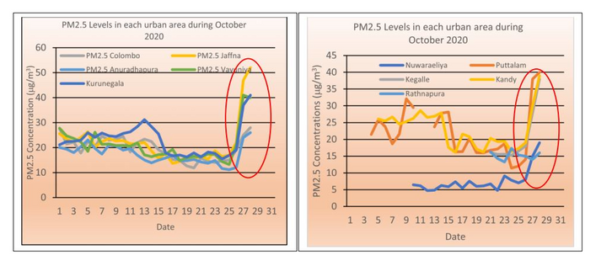
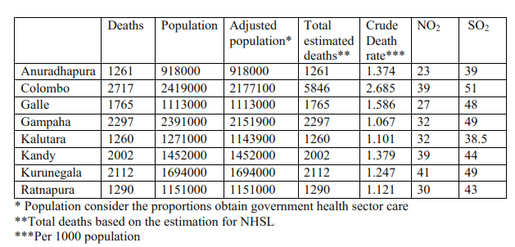
Significant of this study
These table Illustrate the information about the selected disease categories and the discharge mode.
More than one fourth Of the deaths are reported from the ischemic heart diseases.
Almost one fourth Of the patients are discharged live those Who had the 'Other acute lower respiratory infections".
Kriged MAIAC-CAMS-PM2S concentrations at 1 km intervals over Sri Lanka.
This map illustrates the air quality across Sri Lanka.
Several areas are experiencing unexpected increases in air pollution levels.
Comparison of deaths due to the air pollution related diseases and the N02 and S02 concentrations
Cross-tabulation of selected diseases and the discharge mode
Addressing air pollution exposure among school children and the elders is a timely research topic.
By doing so, we can effectively mitigate the adverse effects of air pollution.
Comparison of death rate and air quality levels in selected districts
6
06/05/2024

Slide 7
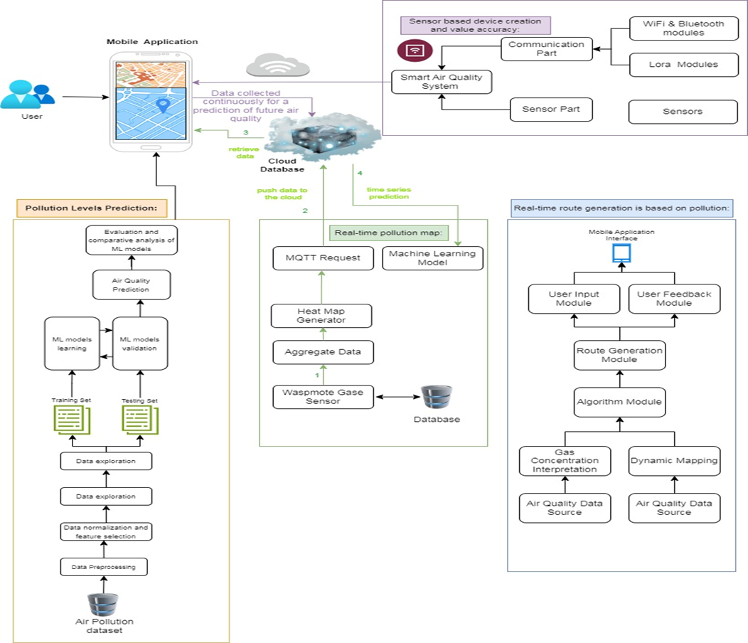
System Diagram
7
06/05/2024

Slide 8

IT21003714 | RIMAS M. J. M
Specialization : Information Technoogy
Component 2 : Sensor based device creation and value accuracy
8
IT21003714 | RIMAS M. J. M | 2024 - 078
10/09/2024

Slide 9

Background
INTRODUCTION
Urban areas in Sri Lanka face severe air pollution, mainly due to vehicle emissions, leading to serious health problems such as respiratory diseases and increased mortality. Existing air quality monitoring systems are often too expensive, offer limited coverage, or lack real-time data capabilities. This situation underscores a critical need for a more affordable, accurate, and real-time air quality monitoring solution. Such a system would help better understand and address the impact of vehicle emissions on both public health and the environment.
The primary focus of this research is to develop and implement a cost-effective IoT-based air pollution monitoring system specifically designed to measure vehicle emissions in urban areas of Sri Lanka
9
IT21003714 | RIMAS M. J. M | 2024 - 078
10/09/2024

Slide 10




Introduction
Research Question
What is the performance of the IoT-based air pollution monitoring system in terms of data accuracy and transmission reliability ?
• How can MQ4, MQ7, and MQ135 sensors be calibrated and integrated with an Arduino ESP32 to ensure accurate detection and measurement of pollutants?
10
IT21003714 | RIMAS M. J. M | 2024 - 078
06/05/2024

Slide 11




Introduction
Specific and Sub Objective
Integrate MQ4 and MQ7 sensors with an Arduino board and get the reading values
Set up MongoDB database to store sensor data securely
Sensor based device creation and value accuracy
Implement Real-Time Data Collection and Transmission(MQTT)
Sensor Integration and Calibration
11
IT21003714 | RIMAS M. J. M | 2024 - 078
06/05/2024

Slide 12
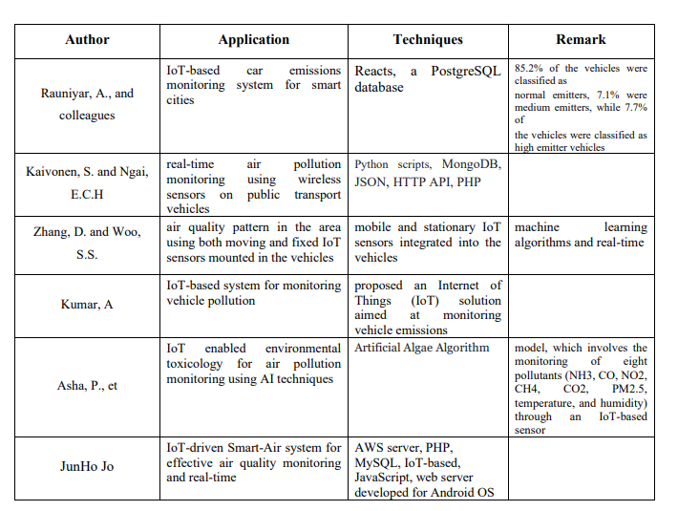
Methodology
Existing Studies on sensor based device creation and value accuracyon
existing studies
12
IT21003714 | RIMAS M. J. M | 2024 - 078
06/05/2024

Slide 13
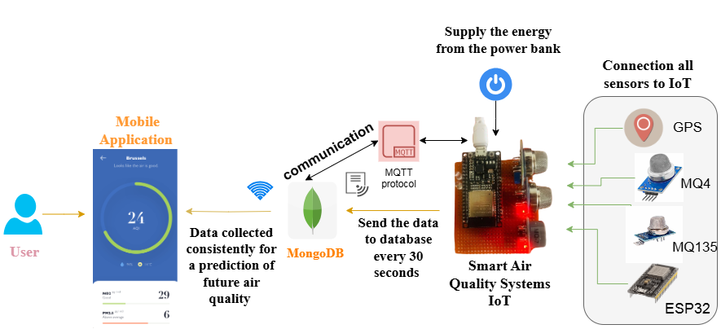
Methodology
System diagram
here we are using mosquito mqtt sever there something call message brokers there are publisher and subscriber when publiser send the some data if there is a subscriber here receive it
IoT data which we are having topic called IOT/data which we created (customizable) and what happening here is that tops are in the MQTT server (broker).When an IoT device is acting as a publishes to that topic (IOT/data) from this channel our toT device Send/ the (Posts) data
13
IT21003714 | RIMAS M. J. M | 2024 - 078
06/05/2024

Slide 14







Used Techniques and Technologies
Techniques
Sensor Calibration and Data Conversion
Use of MongoDB database for storing sensor data securely.
Develop an IoT-Based Air Pollution Monitoring System
Implementation of Arduino code on the Arduino Uno board to handle sensor inputs, process data,
Technologies
React Native
MongoDB
Node Js
Fast API
Arduino IDE
Visual Studio Code
14
IT21003714 | RIMAS M. J. M | 2024 - 078
06/05/2024

Slide 15






Methodology
Evidence of Completion
Connect with Backend server from IoT devices and send the sensor data in database(DB)
create the IoT device
get the real-time Sensor Data from IoT devices
Host the finalized model in the fast server
calculate the sensor data values (PPM) concentration
Displayed the results in mobile application
Using the MQTT Server to send the data to back end
15
IT21003714 | RIMAS M. J. M | 2024 - 078
06/05/2024

Slide 16
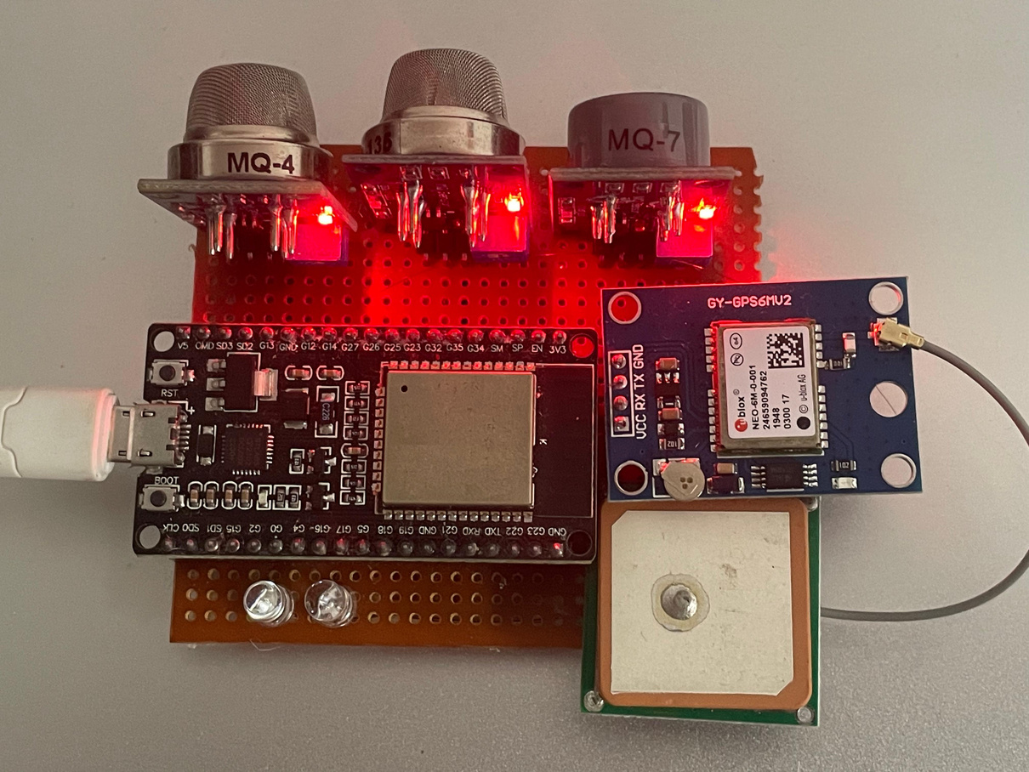
IoT Devices
Evidence of Completion
GPS
MQ7
Arduino ESP32
MQ135
MQ4
16
IT21003714 | RIMAS M. J. M | 2024 - 078
06/05/2024
PM 2.5

Slide 17
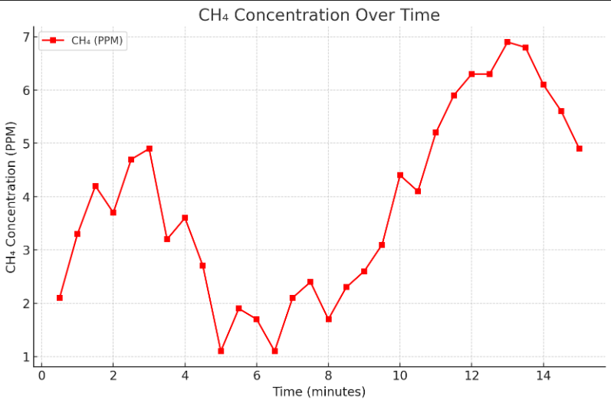
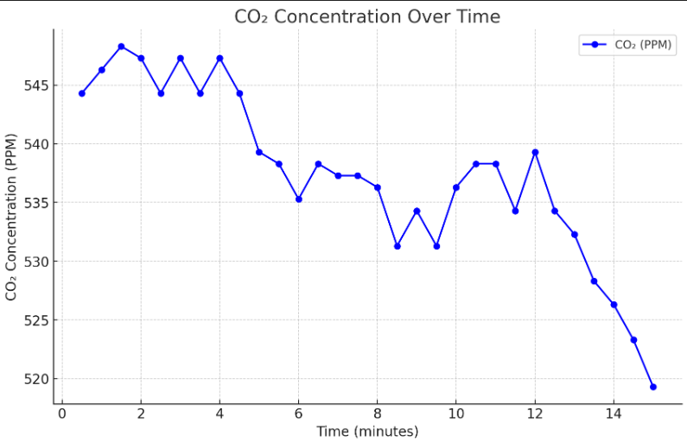
REAL TIME SENSOR DATA COLLECTION(FROM IOT)
Evidence of Completion
ch4 level time
co2
17
IT21003714 | RIMAS M. J. M | 2024 - 078
06/05/2024

Slide 18
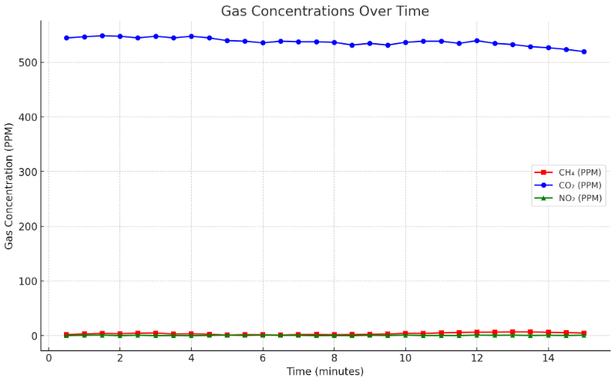
REAL TIME SENSOR DATA COLLECTION(FROM IOT)
Evidence of Completion
17
overall behavior
IT21003714 | RIMAS M. J. M | 2024 - 078
06/05/2024

Slide 19
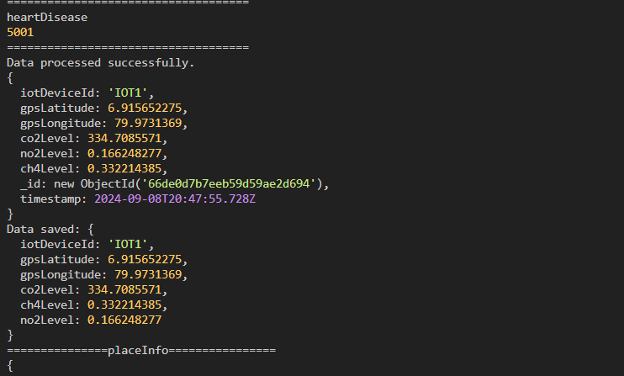
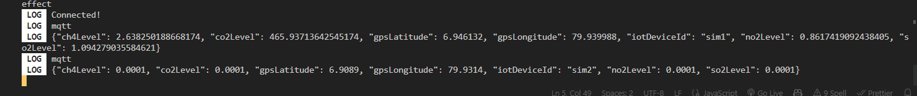
REAL TIME DATA COLLECTION FROM MOBILE APPLICATION
Evidence of Completion
This is the real-time IOT devices data
MQTT server transfer the data
18
IT21003714 | RIMAS M. J. M | 2024 - 078
06/05/2024

Slide 20
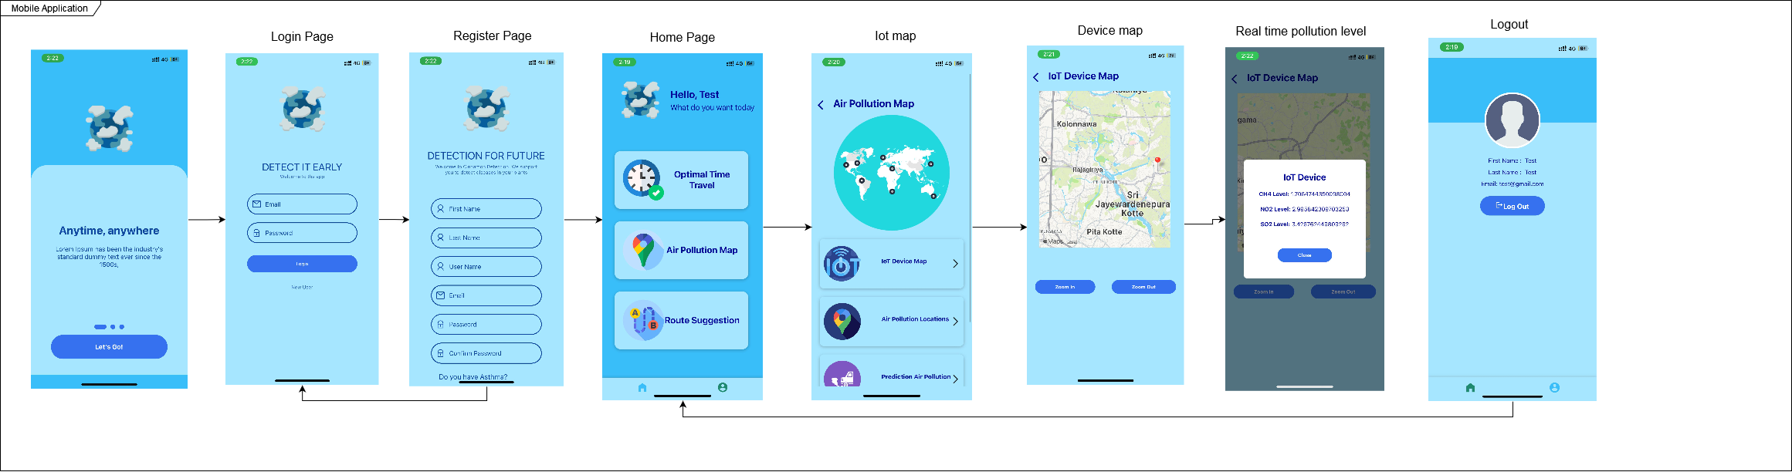
REAL TIME DATA COLLECTION FRONT-END UI PART
Evidence of Completion
19
IT21003714 | RIMAS M. J. M | 2024 - 078
06/05/2024

Slide 21

Functional, Non-Functional and Personnel Requirements
Functional Requirements
Real-Time Data Transmission
Sensor Data Collection:
Set up MongoDB database to store real-time air quality data.
Calculating the PPM value
Implement data transmission at regular intervals (e.g., every 30 seconds) to maintain up-to-date information
Non-Functional Requirements
Personnel Requirements
Identify the sensors and board details to creat an IoT device.
User-friendly interfaces.
Provide continuous operation and data transmission
Ensure compatibility with different mobile platforms (iOS, Android).
21
IT21003714 | RIMAS M. J. M | 2024 - 078
06/05/2024

Slide 22




Completion and Future works
90%
Completion of the components
Build an IoT Device
Reading the data from MQ4 AND MQ7 AND MQ135 sensors
Calculating the PPM value from meter Readings
Connect with the Backend server from IoT devices and send the sensor data to the database
Displayed the real-time pollution level in the mobile application
10%
Future Implementations
UI Enhancement
Increasing The Performance
Bug Fixing
22
IT21003714 | RIMAS M. J. M | 2024 - 078
10/09/2024

Slide 23
References
[1] Naik, U. U., Salgaokar, S. R., & Jambhale, S. (2023). IOT based air pollution monitoring system. Int. J. Sci. Res. Eng. Trends, 9, 835-838.
[2] Pandithurai, O., Jawahar, M., Arockiaraj, S., & Bhavani, R. (2023). IOT Technology Based Vehicle Pollution Monitoring and Control (Doctoral dissertation, Department of Electrical and Electronics Engineering, Mepco Schlenk Engineering College, Sivakasi).
[3] Dhanalakshmi, M. (2021). A survey paper on vehicles emitting air quality and prevention of air pollution by using IoT along with machine learning approaches. Turkish Journal of Computer and Mathematics Education (TURCOMAT), 12(11), 5950-5962.
[4] Potbhare, Piyush Devidas, et al. "IoT based Smart Air Pollution Monitoring System." 2022 International Conference on Applied Artificial Intelligence and Computing (ICAAIC). IEEE, 2022..
[5] [1]Mihăiţă, A. S., Dupont, L., Chery, O., Camargo, M., & Cai, C. (2019). Evaluating air quality by combining stationery, smart mobile pollution monitoring and data-driven modelling. Journal of cleaner production, 221, 398-418..
[6] [1] .N.S. Attanayake and R.A.B. Abeygunawardana, A Comprehensive Comparison of Air Pollution in Main Cities in Sri Lanka Department of Statistics, Faculty of Science, University of Colombo, Colombo 03, Sri Lanka
23
IT21003714 | RIMAS M. J. M | 2024 - 078
06/05/2024

Slide 24
IT21058028 | Inthikhaff M. I. M
Specialization : Information Technoogy
Component 1 : Air Pollution Level Prediction
IT21058028 | Inthikaff M. I. M | 2024 - 078
06/05/2024

Slide 25
Introduction
Background
This component main objective is to predict the Air Pollution Level using regression models such as Random Forest, Linear Regression, Xgbhoost, Support Vactor Regression and Prophet Method.
Our primary focus is on enhancing existing methods to accurately predict and understand air quality.
Colombo consistently experiences an average unhealthy AQI, making reliable predictions crucial for guiding public precautions regarding indoor and outdoor activities.
The correlation between AQI and threats to human health, including short-term and long-term effects, emphasizes the importance of accurate predictions.
Through out this various Model training, we are finding the best model which gives high accuracy in air pollution level prediction.
25
IT21058028 | Inthikaff M. I. M | 2024 - 078

Slide 26
Introduction
Research Question
How to predict air pollution levels of a given time in future and forecasted?
How to filter which inputs(atributes) perform more side effect on air pollution
26
IT21058028 | Inthikaff M. I. M | 2024 - 078
10/09/2024

Slide 27
Introduction
Specific and Sub Objective
Identification of data set, cleaning and preprocessing.
Implement future pollution level prediction and forecasting mechanisms
Training data set using different model and Finding best model which gives high level accuracy.
Graphical and comparative visual representation.
Notification to user when predicted polution level is high
27
IT21058028 | Inthikaff M. I. M | 2024 - 078
10/09/2024

Slide 28
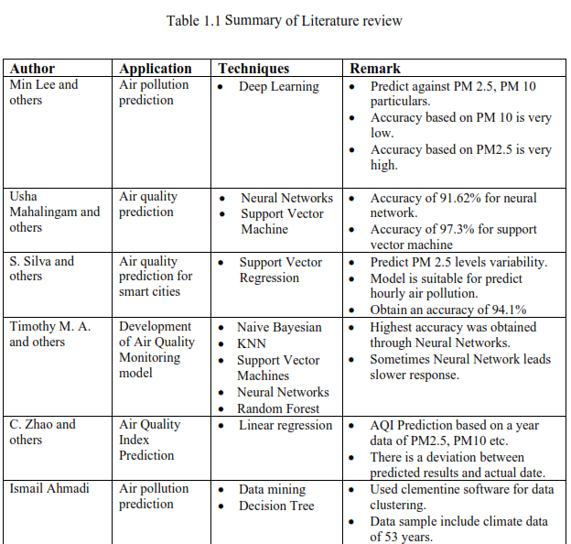
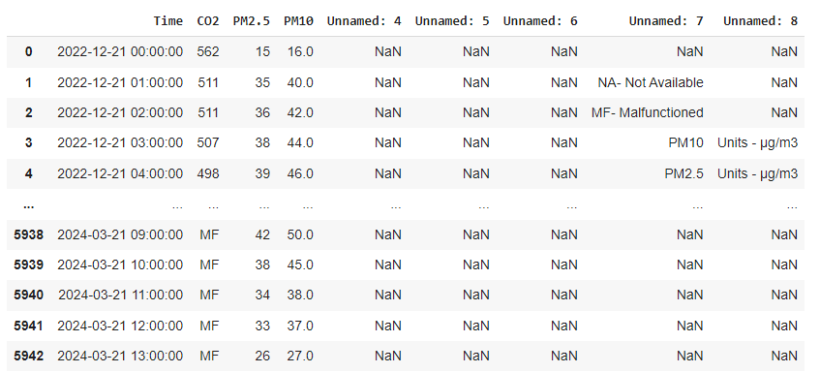
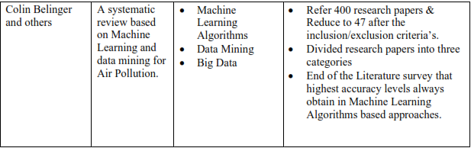
Methodology
Existing Studies on Pollution Level Prediction
From these I have used Time, CO2, PM 2.5 and PM 10 for prediction
28
IT21058028 | Inthikaff M. I. M | 2024 - 078
10/09/2024

Slide 29
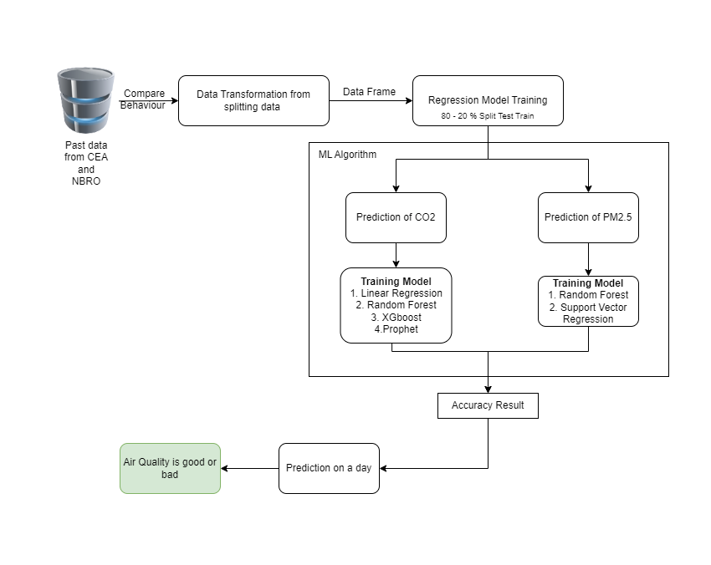
Methodology
System Diagram
29
10/09/2024

Slide 30




Used Techniques and Technologies
Techniques
DataCollection
Data Preprocessing
Normalization
Regularization
Algorithm tuning
Algorithm
Linear Regression
Random Forest
XGBoost (Extreme Gradient Boosting)
Support Vector Regressor
Prophet (Facebook's Forecasting Model)
Technologies
React Native
Python
Fast API
Node Server
Jupyter Notebook
Google Colab
VS code
30
IT21058028 | Inthikaff M. I. M | 2024 - 078
10/09/2024

Slide 31
Methodology
Evidence of Completion
Data collection
Model Testing
Data pre-processing
Data Visualization
Host the finalized model in the fast server
Model Training
Model Evaluation
Displayed the results in mobile application
31
IT21058028 | Inthikaff M. I. M | 2024 - 078
10/09/2024

Slide 32
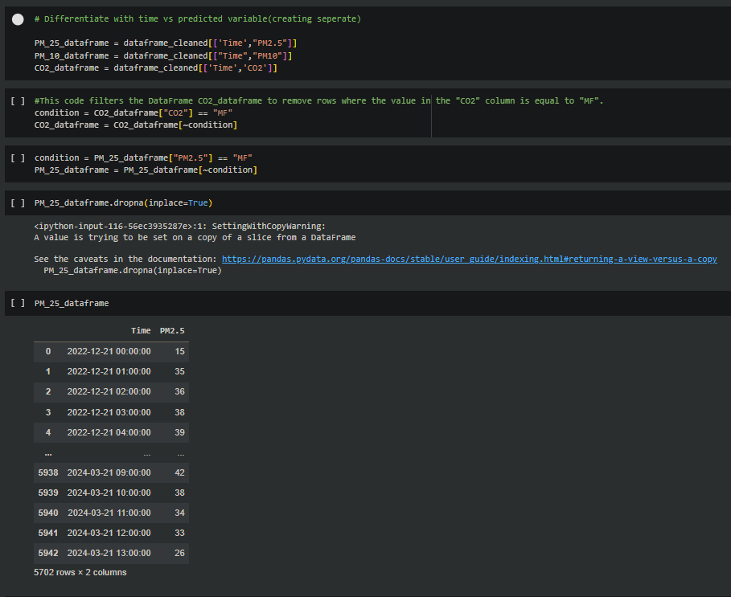
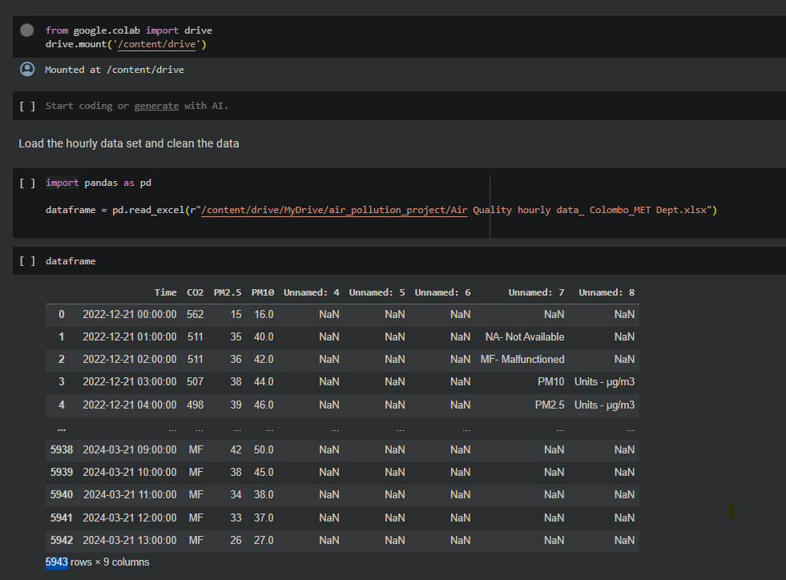
Data Collection and Pre-processing
Data pre-processing implemetation
Data collection implemetation
Classes
Train, Validation and Test data
CO2 (5702)
Train - 4562
Test - 1140
PM 2.5 (3057)
Train - 2446
Test - 611
PM 10 (5703)
Train - 4563
Test - 1140
Total Data : 5943 | Preprocessed Data : 5703 | 80 -20 % Train Test Split
32
IT21058028 | Inthikaff M. I. M | 2024 - 078
10/09/2024
PM 2.5

Slide 33
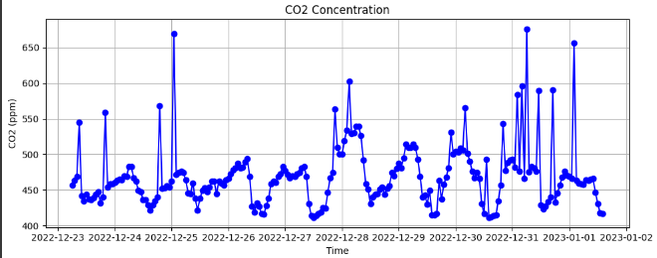
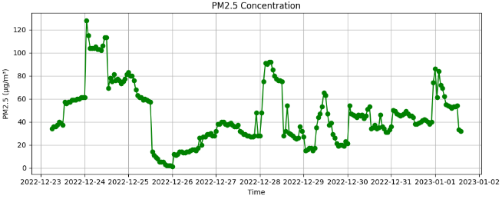
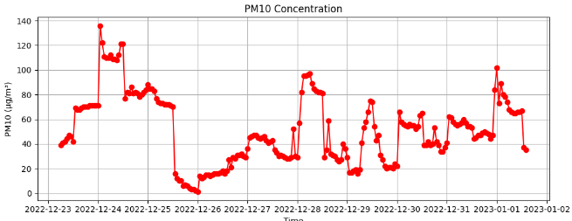
Actual Representation of Data
Evidence of Completion
CO2
PM 2.5
PM 10
33
IT21058028 | Inthikaff M. I. M | 2024 - 078
10/09/2024

Slide 34
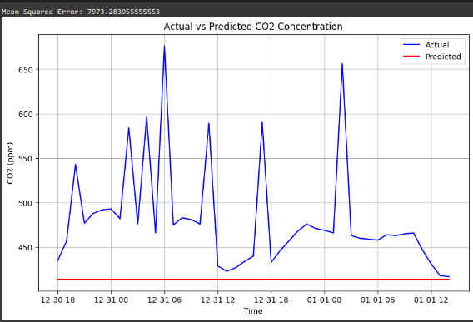
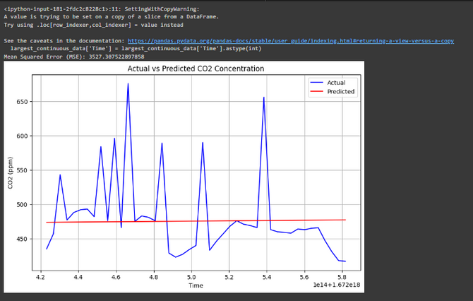
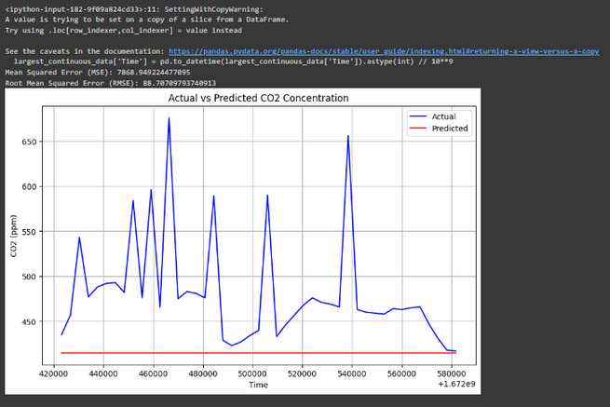
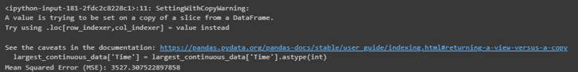
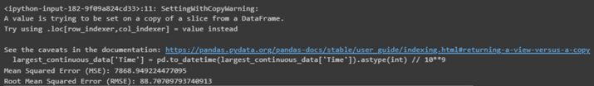
Train Model - CO2
Evidence of Completion
Random Forest
Linear Regression
XGbhoost
MSE - 7973.28
MSE - 3527.31
MSE - 88.71
Lover value indicates a better fit in MSE
34
IT21058028 | Inthikaff M. I. M | 2024 - 078
10/09/2024

Slide 35
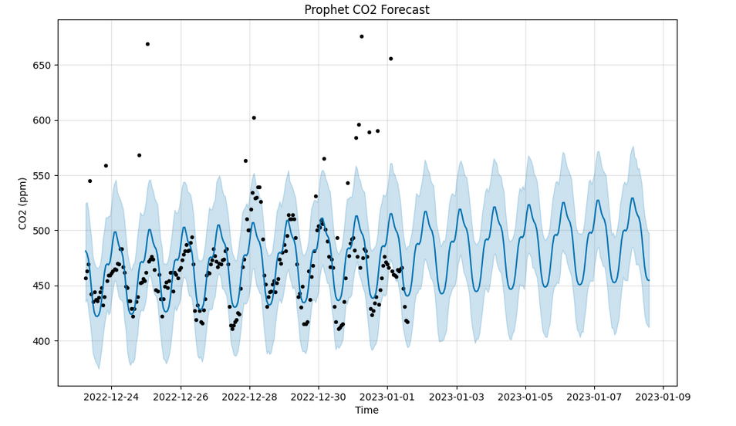
Train Model - CO2
Evidence of Completion
Prophet
According to MSE values
Random Forest < Linear Regression < XGbhoost < Prophet
MSE - 54.45
Lover value indicates a better fit in MSE
35
IT21058028 | Inthikaff M. I. M | 2024 - 078
10/09/2024

Slide 36
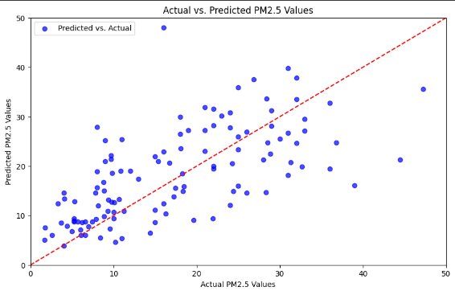
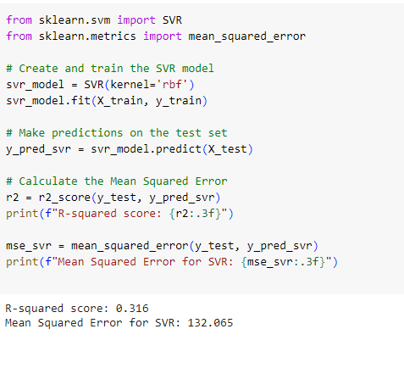
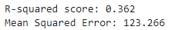
Training Model - PM 2.5
Evidence of Completion
Random Forest
Suppor Vector Regressor
MSE - 123.26
RMSE - 132.065
Lover value indicates a better fit in MSE
36
IT21058028 | Inthikaff M. I. M | 2024 - 078
10/09/2024

Slide 37
Functional, Non-Functional and Personnel Requirements
Functional Requirements
Non-Functional Requirements
Personnel Requirements
Polluted Air Data Collection and Preprocessing(clean and transform)
Feature Selection and Analysis
Model Development and Training
Explore and select the most suitable predictive model based on accuracy metrics.
Dynamic Predictions for Real-time Adjustments.
Real-time Pollution Data and Comparison and Visualization.
User-friendly Interfaces.
Should properly work in cross platforms (for android and IOS devices)
The application should be reliable.
Higher accuracy of results.
Results should be more efficient.
Resources and Dataset Air pollution level in Colombo
Central Environment Authority (CEA)
The National Building Research Organization (NBRO).
37
IT21058028 | Inthikaff M. I. M | 2024 - 078
10/09/2024

Slide 38
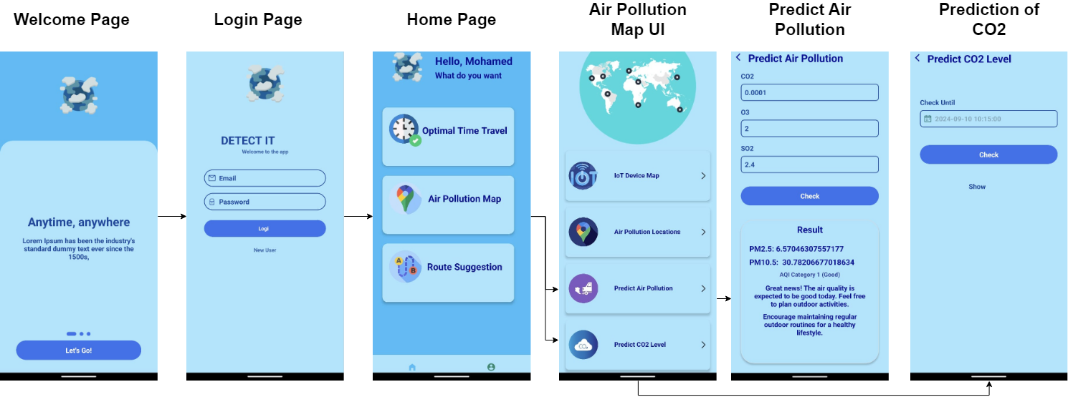
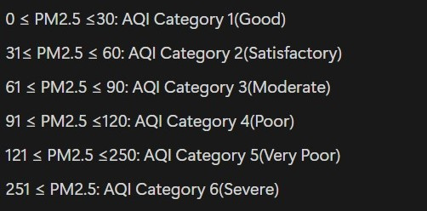
Evidence of Completion
39
10/09/2024

Slide 39
Completion and Future works
90%
Completion of the components
Polluted Air Data Collection and Preprocessing, Cleaning and Transforming.
Identification of the best Model for predicting CO2 level in the environment - (Sub-Objective 02
Identification of the best model for predicting PM 2.5 - (Sub-Objective 03)
Host the finalized model in the fast server
Displayed the results in mobile application
10%
Future Implementations
UI Enhancement
Increasing The Performance
Bug Fixing
38
IT21058028 | Inthikaff M. I. M | 2024 - 078
06/05/2024

Slide 40
References
[1] S. Mahanta, T. Ramakrishnudu, R. R. Jha, and N.Tailor, “Urban Air Quality Prediction Using RegressionAnalysis,” in TENCON 2019 - 2019 IEEERegion 10 Conference (TENCON), Kochi, India,Oct. 2019, pp. 1118–1123. doi: 10.1109/TENCON.2019.8929517.
[2] M. Castelli, F. M. Clemente, A. Popoviˇc, S. Silva,and L. Vanneschi, “A Machine Learning Approachto Predict Air Quality in California,” Complexity,vol. 2020, pp. 1–23, Aug. 2020, doi:10.1155/2020/8049504.
[3] S. Zhong, Z. Yu, and W. Zhu, “Study of the Effectsof Air Pollutants on Human Health Based onBaidu Indices of Disease Symptoms and Air QualityMonitoring Data in Beijing, China,” IJERPH,vol. 16, no. 6, p. 1014, Mar. 2019, doi:10.3390/ijerph16061014.
[4] Y. L. S. Nandasena, A. R. Wickremasinghe, andN. Sathiakumar, “RAesierarpchoarltilculetion andhealth in Sri Lanka: a review of epidemiologic studies,”p. 14, 2010.
[5] T. Xayasouk and H. Lee, “AIR POLLUTION PREDICTIONSYSTEM USING DEEP LEARNING,”Naples, Italy, Jun. 2018, pp. 71–79. doi:10.2495/AIR180071.
[6] D. Iskandaryan, F. Ramos, and S. Trilles, “AirQuality Prediction in Smart Cities Using MachineLearning Technologies based on Sensor Data: AReview,” Applied Sciences, vol. 10, no. 7, p. 2401,Apr. 2020, doi: 10.3390/app10072401.
39
06/05/2024

Slide 41
IT21152832 | Kumari J.M.D
Specialization : Information Technology
Component 3 : Realtime Pollution Map(Heatmap)
IT21152832 | Kumari J.M.D | 2024 - 078
08/05/2024

Slide 42
Introduction
Background
My component main objective is to develop all about the Real-Time Pollution Heatmap,Recommendation of optimal travel time and Risk exposure analysing, particularly for those affected by air pollution-related diseases.
Collecting the values of CH4, CO2, SO2, NO2 gases in real-time, providing with up-to-date pollution data through visualizations and personalized recommendations in realtime pollution map, users can minimize exposure.
Optimal travel times recommendation, predicts the best times to travel based on current and forecasted air pollution levels
Risk exposure analysis provide real-time notifications, especially for users with health conditions, to help them avoid high-pollution areas and reduce risk exposure
41
IT21152832 | Kumari J.M.D | 2024 - 078
08/05/2024

Slide 43

Research Question
1
How can a real-time, color-coded heat map be effectively used to represent varying levels of air pollution across different geographic locations?
2
what method can be used for Recommendation of optimal travel time in low pollution with low exposure of effect ?
How can a mobile application effectively communicate the health risks of air pollution, affecting by the health diseases of users ?
3
42
IT21152832 | Kumari J.M.D | 2024 - 078
08/05/2024

Slide 44

Specific and Sub Objective
Identify high or low gas concentration levels for CH4, CO2, SO2, and NO2 gases values and Implement a Real-Time Air Quality Heat Map.
Specific Objective
To develop a real-time pollution map that provides accurate and timely air quality data, enabling users, particularly those with health conditions, to make informed decisions and minimize their exposure to harmful pollutants.
Develop an Optimal Travel Time Recommendation (Predict the best times for users to travel based on current and forecasted pollution levels)
Create a Real-Time Risk Exposure Analysis and Provide real-time notifications(using pollution levels, location, and user health status)
43
IT21152832 | Kumari J.M.D | 2024 - 078
08/05/2024

Slide 45
Methodology
Aspect | Existing Solutions | Gap Identified | Proposed System
Real-time Monitoring | Limited sensors, non-integrated systems | Lack of comprehensive real-time monitoring | Integrated real-time data from multiple sensors
Visualization of Air Quality | Basic maps, no user-friendly visual cues | Inadequate user interface, no color-coded alerts | Heatmaps with color-coded schemes, intuitive UI
Travel Recommendations | Static recommendations, non-predictive | No real-time, predictive travel recommendations | Predictive models for real-time travel suggestions
Risk Exposure Analysis | General health risk assessments | No personalized risk exposure alerts and no low-risk time recommendation based on user health conditions | Personalized alerts and recommendation time in Low exposure risk based on specific health conditions
Existing Studies
44
IT21152832 | Kumari J.M.D | 2024 - 078
08/05/2024

Slide 46
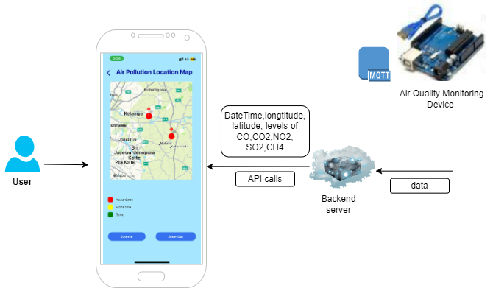
System Diagram
45
IT21152832 | Kumari J.M.D | 2024 - 078
08/05/2024

Slide 47
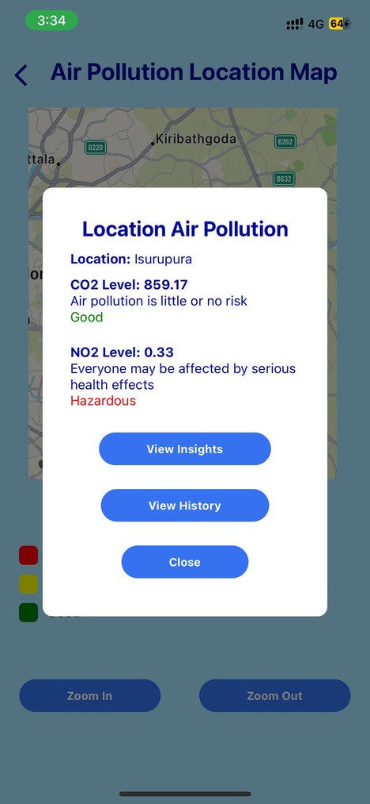
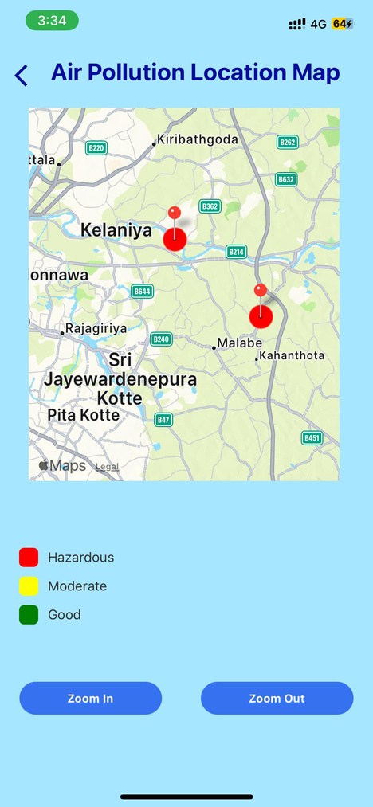
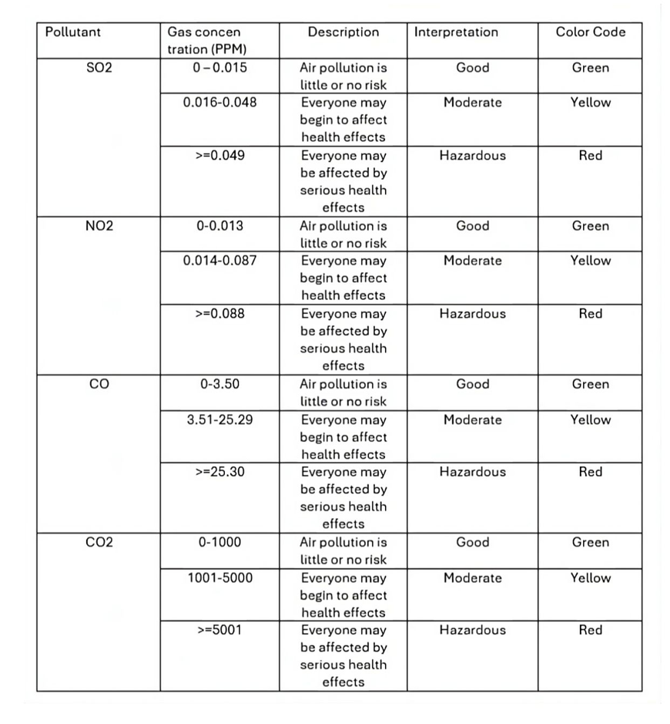
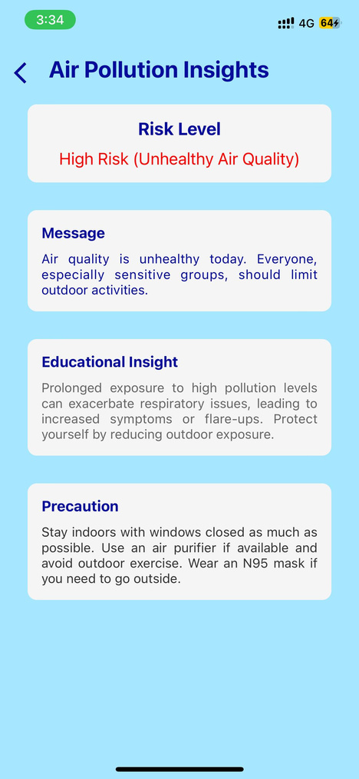
Air Pollution Location Map
Evidence of Completion
threshold values to say air quality based on location is good or medrate or hazardous?
45
IT21152832 | Kumari J.M.D | 2024 - 078
08/05/2024

Slide 48
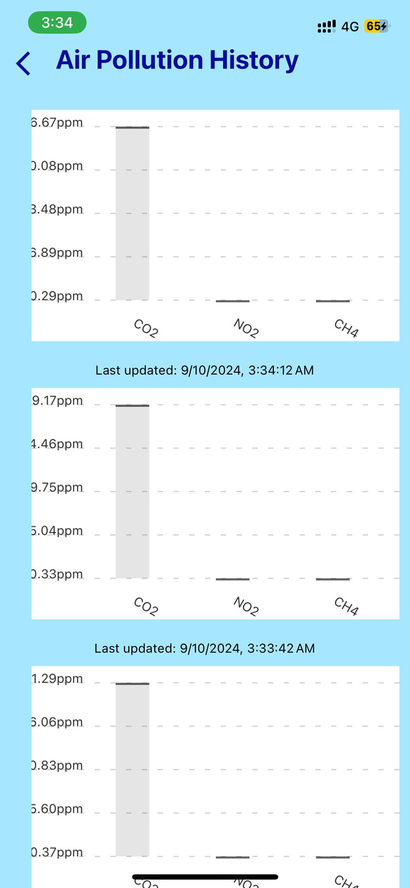
Air Pollution Location Map
Evidence of Completion
Show the Last updated Air pollution data in CO2, NO2 and CH4 levels
45
IT21152832 | Kumari J.M.D | 2024 - 078
08/05/2024

Slide 49

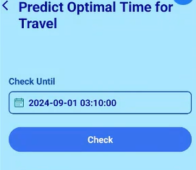
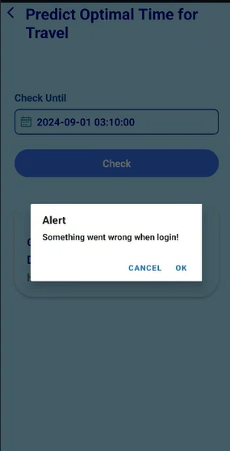
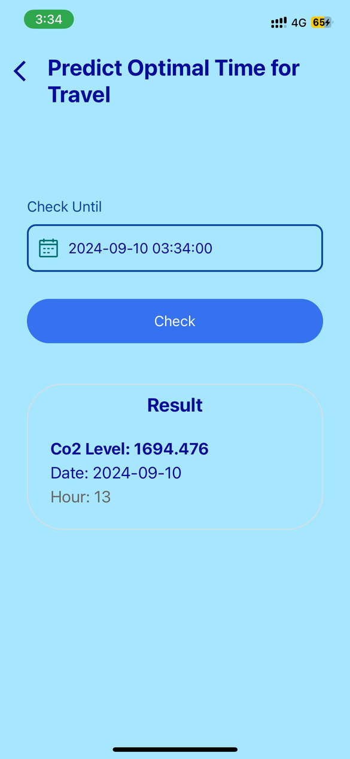
Optimal Travel Time Prediction
Evidence of Completion
Show the Error Message
Show the Lesser CO2 level until the End date and
show the Optimal time for the travel
48
IT21152832 | Kumari J.M.D | 2024 - 078
08/05/2024

Slide 50
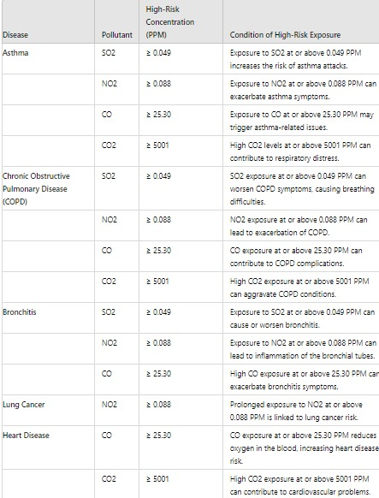
Backend Result of Risk Exposure Analysis
Evidence of Completion
threshold values of Air Quality affect for the health diseases(WHO Air Quality Guidlines)
49
IT21152832 | Kumari J.M.D | 2024 - 078
08/05/2024

Slide 51
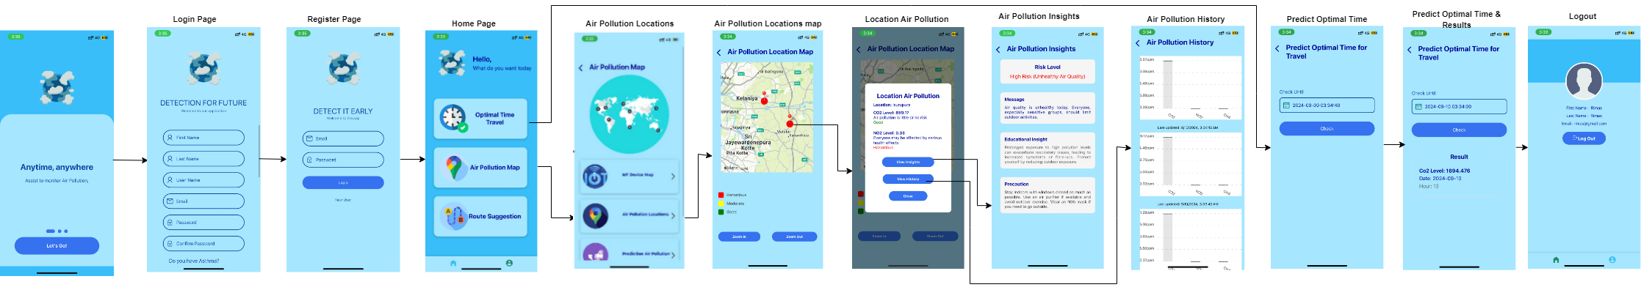
Display the Final Results in Application
50
IT21152832 | Kumari J.M.D | 2024 - 078
08/05/2024

Slide 52



Used Techniques and Technologies
Technologies and Libries
React Native
MongoDB
Google Map
React Marker
Vs code
Techniques
Visualization Tools
Geographic Information Systems (GIS)
Sensor Technology
Internet of Things(IOT) Monitoring System
Notification system
45
IT21152832 | Kumari J.M.D | 2024 - 078
08/05/2024

Slide 53

Completion and Future works
90%
Completion of the component
Display Air levels for CH4, CO2, SO2, and NO2 gases values on the heatmap based on different locations, show the history of air pollution and insights of air pollution
Map integration with Google Maps API
Data Visualization and Mapping in mobile application
Connect with Server backend to integrate with Realtime pollution levels and data
Recommendation of optimal travel time using current and forcasted air quality data
Backend implementation of Risk exposure level, espcially those affected by health diseases
10%
Future Implementations
UI Enhancement
Bugs Fixing
Increasing the performance
Push Notification
51
IT21152832 | Kumari J.M.D | 2024 - 078
06/05/2024

Slide 54
References
[1]Castell, N., Dauge, F.R., Schneider, P., Vogt, M., Lerner, U., Fishbain, B., Broday, D., and Bartonova, A. (2017). "Can commercial low-cost sensor platforms contribute to air quality monitoring and exposure estimates?" Environment International, 99, 293-302.
[2]Zhang, W., Vazquez-Canteli, J.R., and Sadiq, R. (2016).” A real-time air quality routing algorithm: Reducing human exposure to outdoor air pollution. “69, 281-300.
[3]Tsai, J.H., Lv, N., and Wang, Y. (2016). “A heatmap-based visualization framework for air pollution monitoring data. Journal of Ambient Intelligence and Humanized Computing,” 7(4), 499-512.
[4]“What are the WHO Air quality guidelines?,” WHO newsroom, Sep.22, 2021. [Online]. Available:https://www.who.int/news-room/feature-stories/detail/what-are-the-who-air-quality-guidelines
[5]A. Manuel, G. F. Sathyraj, R. C. Joseph, S. A. Philip, and S. M. Thomas, "AI-Integrated IoT-Enabled Smart Mask For SoS Alerting And Disease Prediction Based On Air Pollutants," in Proc. 2023 Int. Conf. Signal Process., Comput., Electron., Power, Telecommun. (IConSCEPT), 2023, pp. 1-6
52
IT21152832 | Kumari J.M.D | 2024 - 078
08/05/2024

Slide 55
IT21057588 | Pasan M.G.R
Specialization : Information Technoogy
Component 4 : Route Generation Based on pollution
IT21057588 | Pasan M.G.R | 2024 - 078
06/05/2024

Slide 56
Introduction
Background
.
Proposing the least air pollution shortest route when there are several routes to go between two locations within the Colombo district.
A new algorithm has been developed by combining Dijkstra’s algorithm and the dynamic mapping process to suggest the best way.
Finally, the suggested shortest path and pollution levels for the route are sent to the Mobile application to display it on the map.
02
IT21057588 | Pasan M.G.R | 2024 - 078
06/05/2024

Slide 57
Research Questions
How data service for accessing and processing road network information.
How is the shortest route identified?
How is the Pollution Level Considered in the Route Map
9
IT21057588 | Pasan M.G.R| 2024 - 078
06/05/2024

Slide 58




Introduction
Specific and Sub Objective
Identification of data set, cleaning and preprocessing.
Identification of Polluted Route Areas
Route Generation
Based on
Pollution
Writing algorithm to calculate the near distance level low polluted route
Finding best route with low pollution level
02
IT21057588 | Pasan M.G.R | 2024 - 078
06/05/2024

Slide 59
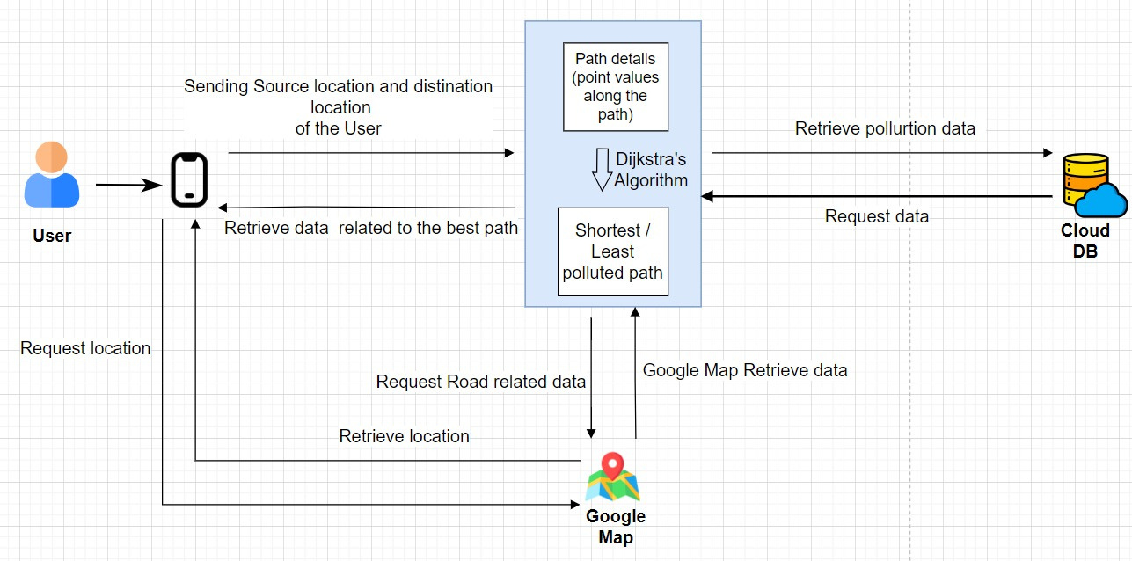
System Diagram
02
IT21057588 | Pasan M.G.R | 2024 - 078
06/05/2024

Slide 60




Used Techniques and Technologies
Technologies
DataCollection
Algorithm tuning
Algorithm
Dijkstra’s Algorithm
Techniques
React Native
Python
Fast API
Node JS
Google Collab
VS code
MongoDB
12
IT21057588| Pasan M.G.R | 2024 - 078
06/05/2024

Slide 61
Methodology
Evidence of Completion
Data collection
Host the finalized model in the fast api
Deviloping backend calling Api
Model Evaluation
Frontend development and Display the result in mobile application
Model Testing
13
IT21057588 | Pasan M.G. | 2024 - 078
06/05/2024

Slide 62
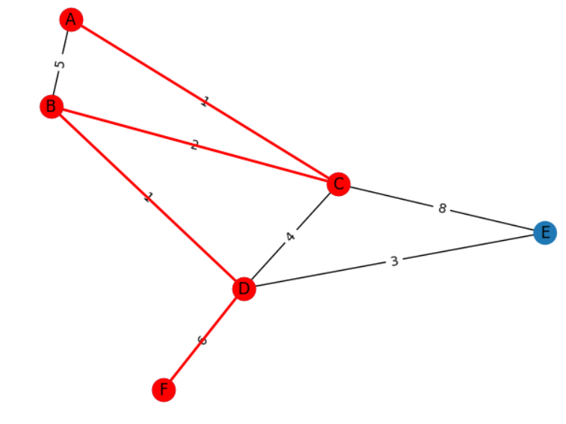
Output Graph For Dijkstra’s Algorithm
As example
1
4
6
A
C
D
F
=11
02
5
3
6
=14
A
B
D
F
IT21057588 | Pasan M.G.R | 2024 - 078
06/05/2024

Slide 63



Display the result in Application
02
IT21057588 | Pasan M.G.R | 2024 - 078
06/05/2024

Slide 64


System, Personnel, and
Software Specification Requirements
Functional Requirements
Non-Functional Requirements
When there are multiple routes between any two locations, display the non-polluted route on the map.
Algorithms should be used to select the path with the least pollution level.
The pollutant concentration data should be displayed above the minimum path of the Pottution level .
Interfaces should be User-friendly
Should properly work for android and IOS devices
The application should be reliable
Higher accuracy of results
Results should be more efficient
38
IT21057588 | Pasan M.G.R | 2024-078
3/8/2021

Slide 65


Completion and Future works
Completion of the components
90%
path visulization using dijkarst Algoridum.
Disease Visualization to CRISL and Dispersion Visualization using Google Map API
The shortest distance route is shown on the map.
The Optimal trapic route is shown on the map.
The optimal pollution route is shown on the map.
10%
Future Implementations
Bugs Fixing
Increasing the performance
76
UI Enhancement
IT21057588 | Pasan M.G.R| 2024 - 078
3/8/2021

Slide 66
References
Wang, Z., Novack, T., Yan, Y. and Zipf, A., 2020. Quiet route planning for pedestrians in traffic noise polluted environments. IEEE Transactions on Intelligent Transportation Systems, 22(12), pp.7573-7584.
Yang, J., Cai, B., Li, X. and Ge, R., 2023, May. Optimal path planning for electric vehicle travel time based on Dijkstra. In 2023 35th Chinese Control and Decision Conference (CCDC) (pp. 721-726). IEEE.
Zheng, Z., Yao, S., Li, G., Han, L. and Wang, Z., 2023. Pareto Improver: Learning Improvement Heuristics for Multi-Objective Route Planning. IEEE Transactions on Intelligent Transportation Systems.
Jayalath, K.G., Deeyamulla, M.P. and de Silva, R.C.L., 2023. An Assessment of Transboundary Pollution from Colombo to Kandy on the Atmospheric Deposition of Heavy Metals Using Moss (Hyophila involuta). Sri Lankan Journal of Applied Sciences, 2(01), pp.39-43.
Identification of data set, cleaning and preprocessing.
02
IT21057588 | Pasan M.G.R | 2024 - 078
06/05/2024

Slide 67
Thank You !
3/8/2021

